Slide 1
Data Structures
ICT-1211
Information and Communication Technology
Lecture-14
Date: //2024

Slide 2
Linked Lists

Slide 3
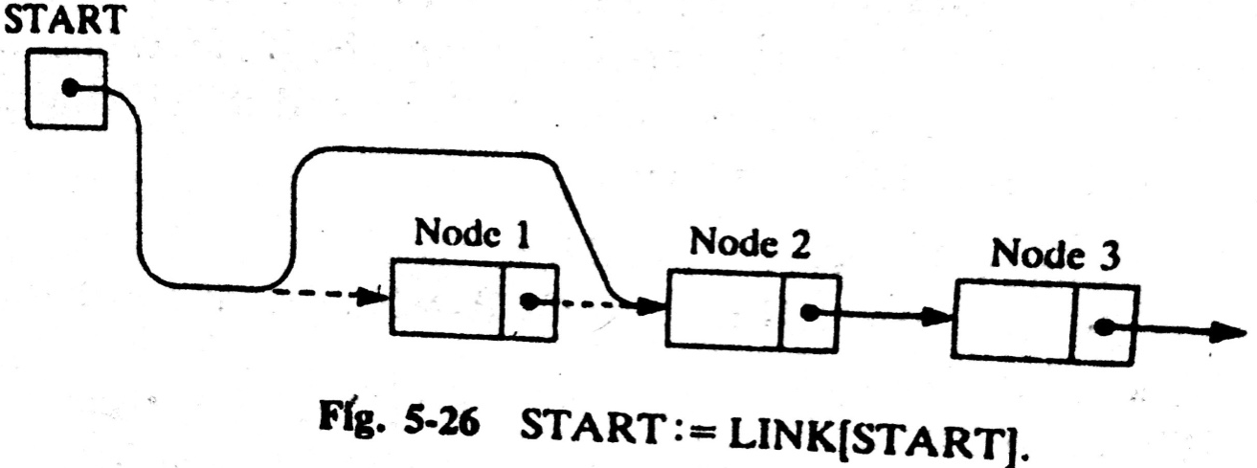
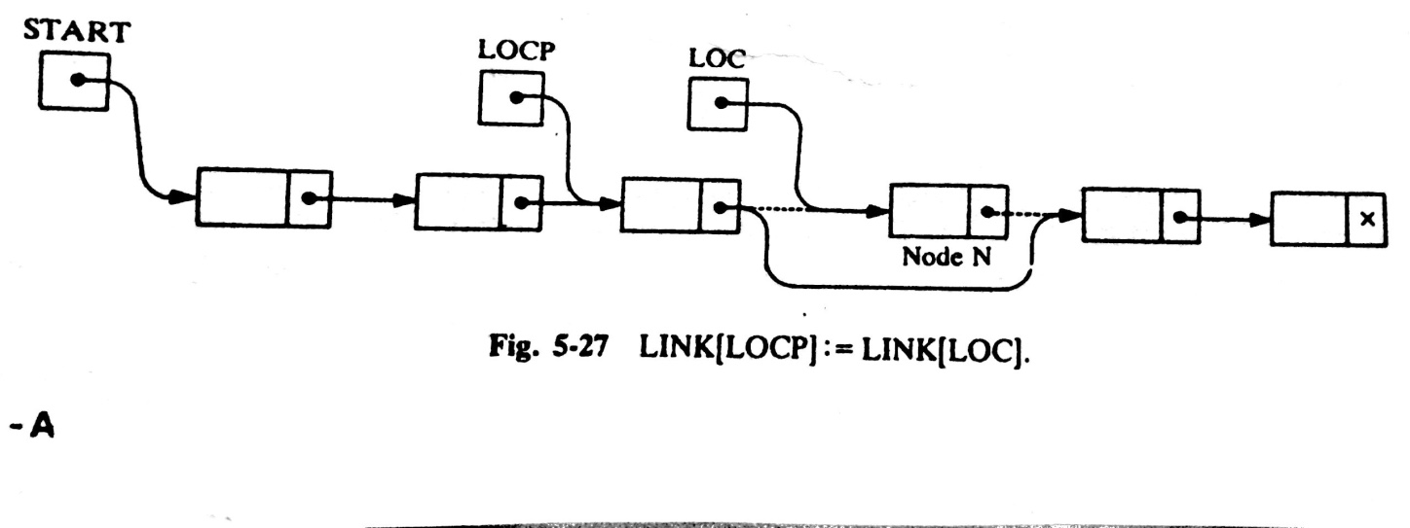
LINKED LISTS: Deleting the node following a Given Node
DEL(INFO, LINK, START, AVAIL, LOC, LOCP)
(it deletes the node N with location LOC, LOCP is the location of the node which precedes N)
Step 1. If LOCP=NULL, then:
Set START:=LINK[START]. [Delete first node.]
Else:
Set LINK[LOCP]:=LINK[LOC]. [Deletes node N.]
[End of If structure]
Step 2. [Return deleted node to the AVAIL list.]
Set LINK[LOC]:=AVAIL and AVAIL:=LOC.
Step 3. Exit.

Slide 4
LINKED LISTS: Deleting the node with a given ITEM
Let LIST be a linked list in memory.
Suppose we are given an ITEM of Information and we want to delete from the LIST the first node which contain ITEM.
The algorithm has TWO PARTS
  First we give a procedure which finds the location LOC of the node N containing ITEM, and the location LOCP of the node preceding node N.
      If N is the first node with ITEM, we set LOCP=NULL
      If ITEM does not appear in LIST, we set LOC=NULL
  Traverse the list, using pointer variable PTR and comparing ITEM with INFO[PTR]at each node.
      While track the location of the preceding node by using a pointer variable SAVE. Thus
      SAVE:= PTR and PTR:= LINK[PTR]

Slide 5
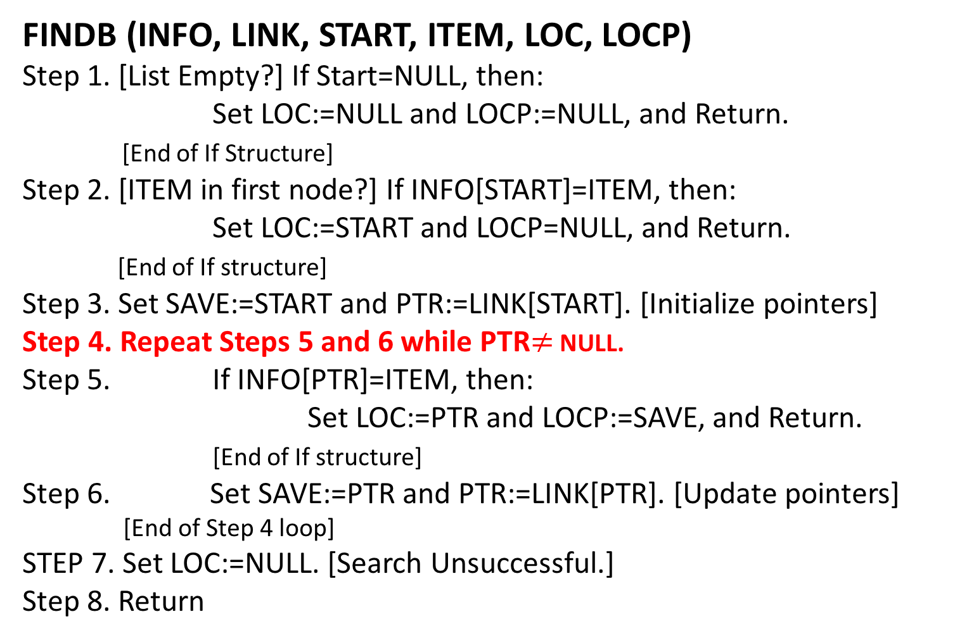
LINKED LISTS: Find LOC of the 1st node N which contains ITEM
FINDB (INFO, LINK, START, ITEM, LOC, LOCP)
Step 1. [List Empty?] If Start=NULL, then:
Set LOC:=NULL and LOCP:=NULL, and Return.
[End of If Structure]
Step 2. [ITEM in first node?] If INFO[START]=ITEM, then:
Set LOC:=START and LOCP=NULL, and Return.
[End of If structure]
Step 3. Set SAVE:=START and PTR:=LINK[START]. [Initialize pointers]
Step 4. Repeat Steps 5 and 6 while PTR$≠$ NULL.
Step 5. If INFO[PTR]=ITEM, then:
Set LOC:=PTR and LOCP:=SAVE, and Return.
[End of If structure]
Step 6. Set SAVE:=PTR and PTR:=LINK[PTR]. [Update pointers]
[End of Step 4 loop]
STEP 7. Set LOC:=NULL. [Search Unsuccessful.]
Step 8. Return

Slide 6
LINKED LISTS: Delete the 1st node which contains the given ITEM of Info
DELETE (INFO, LINK, START, AVAIL, ITEM)
Step 1. Call FINDB(INFO, LINK, START, ITEM, LOC, LOCP)
Step 2. If LOC=NULL, then: Write: ITEM not in list, and Exit.
Step 3. [Delete node.]
If LOCP=NULL, then
Set Start:=LINK[START]. [Delete fist node]
Else:
Set LINK[LOCP]:=LINK[LOC].
[End of If structure]
Step 4. [Return deleted node to the AVAIL list.]
Set LINK[LOC]:=AVAIL and AVAIL:=LOC.
Step 5. Exit

Slide 7
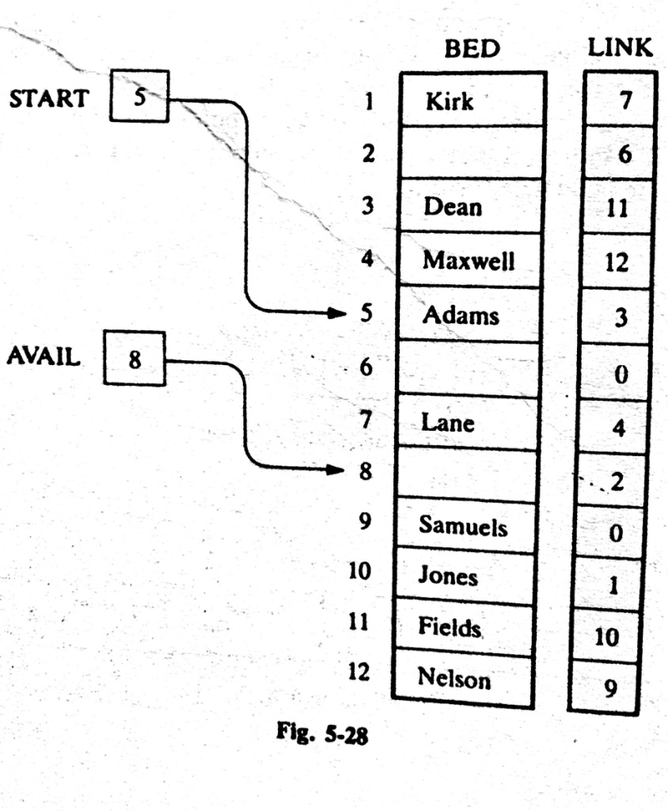
LINKED LISTS:
Example 5.17 Teach Yourself

Slide 8
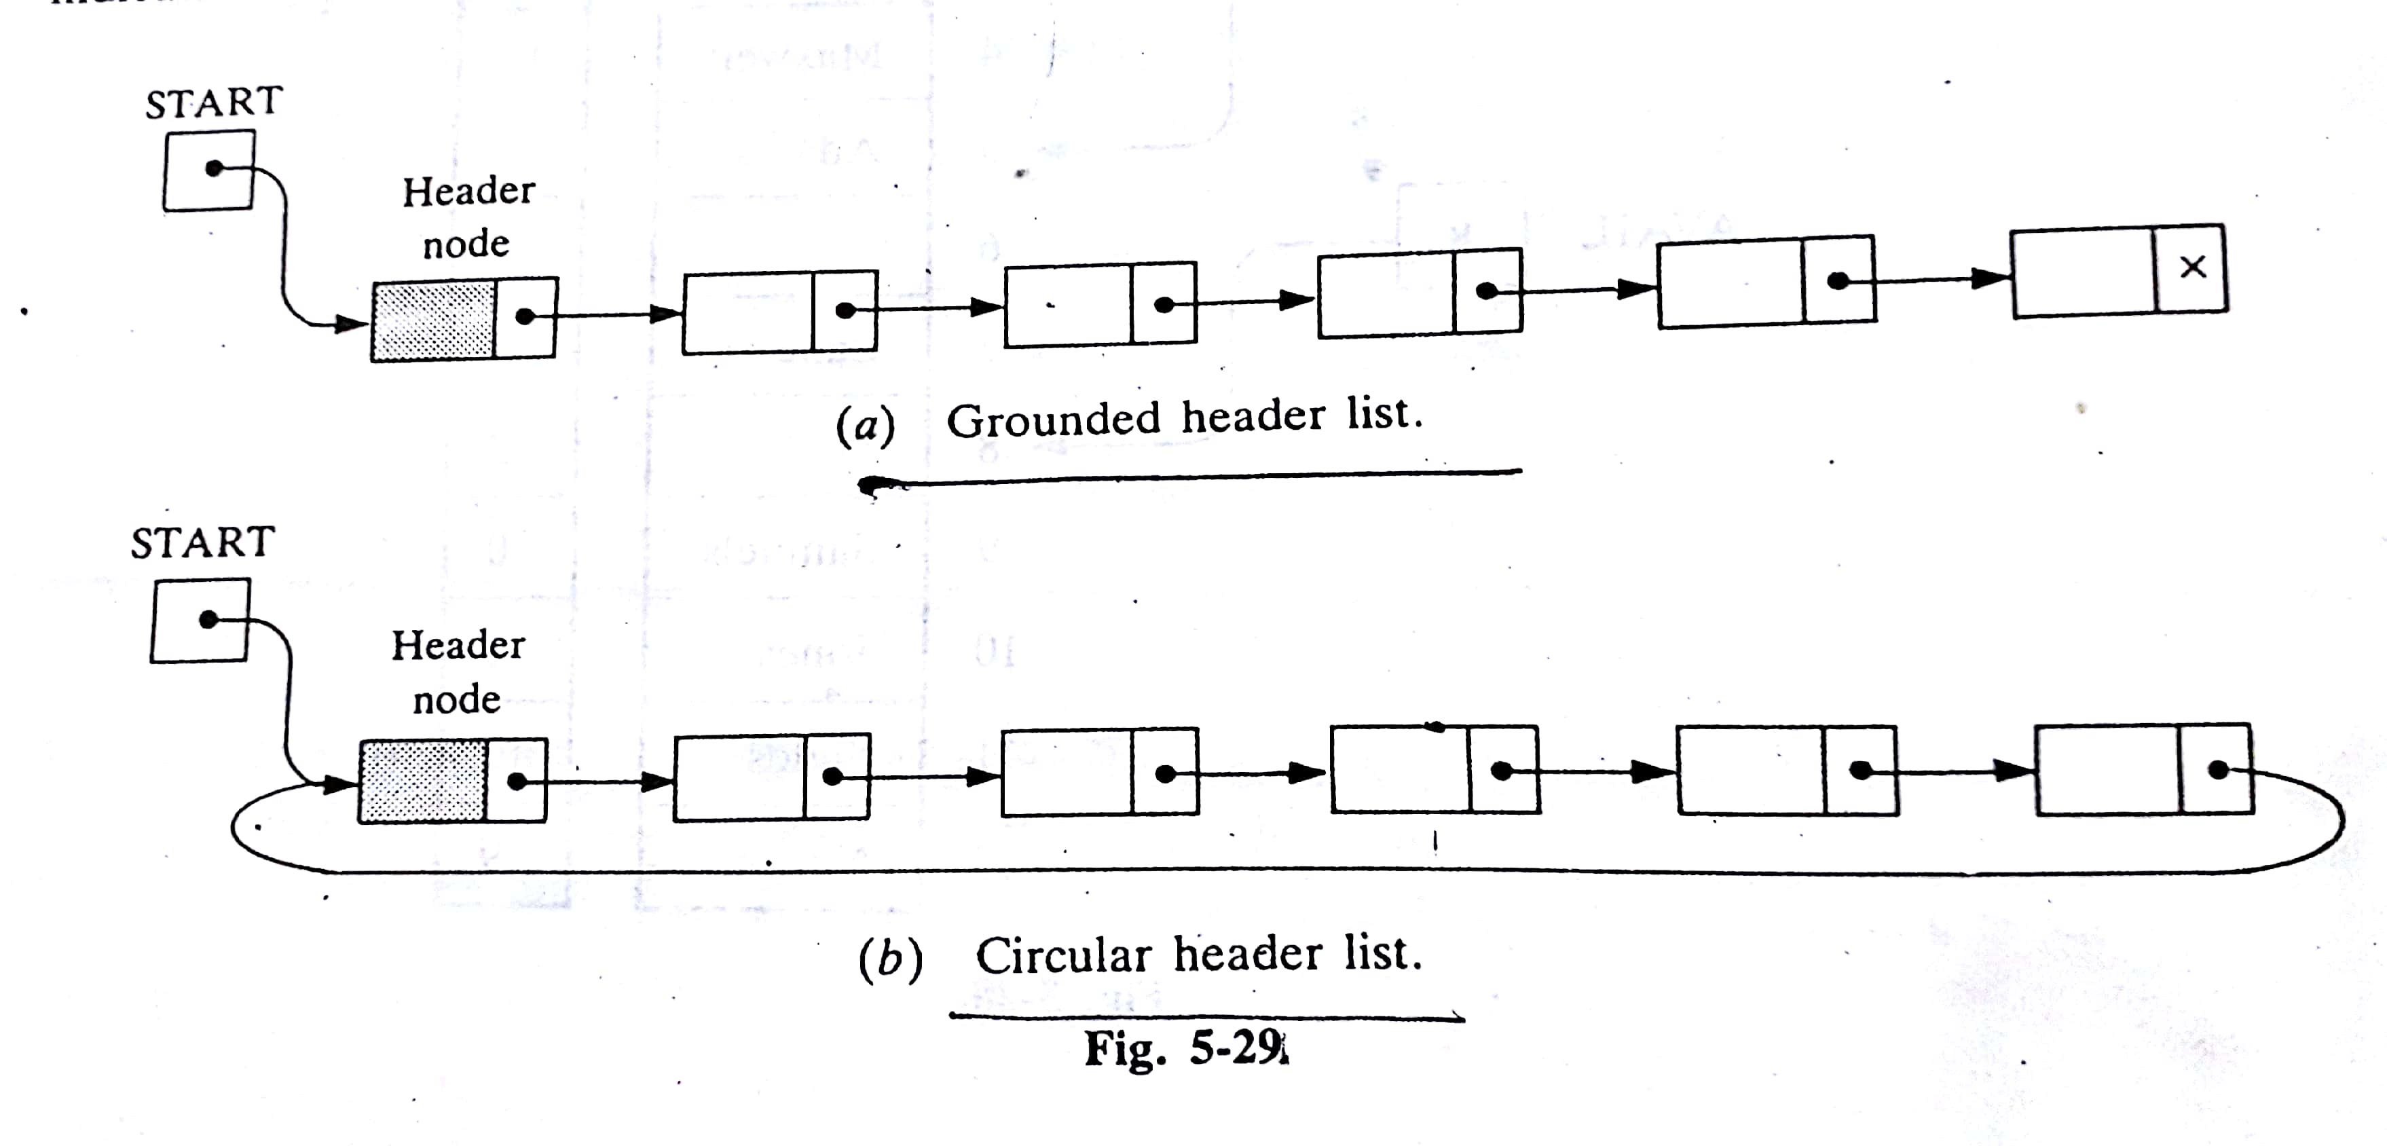
Header Linked LISTS
A header lined list is a linked list which always contains a special node, called the header node, at the beginning of the list.
The following are two kinds of widely used header lists:
  A Grounded Header List:
  A Circular List:

Slide 9
Header Linked LISTS
  Grounded Header List: is a header list where the last node contains the null pointer.
  Observe that, the list pointer START always points to the header node.
  Accordingly, LINK[START] =NULL indicates that a grounded header list is empty.

Slide 10
Header Linked LISTS
  A Circular Header List: is a header list where the last node points back to the header node.
  Observe that, the list pointer START always points to the header node.
  LINK[START]=START indicates that a circular header list is empty.

Slide 11
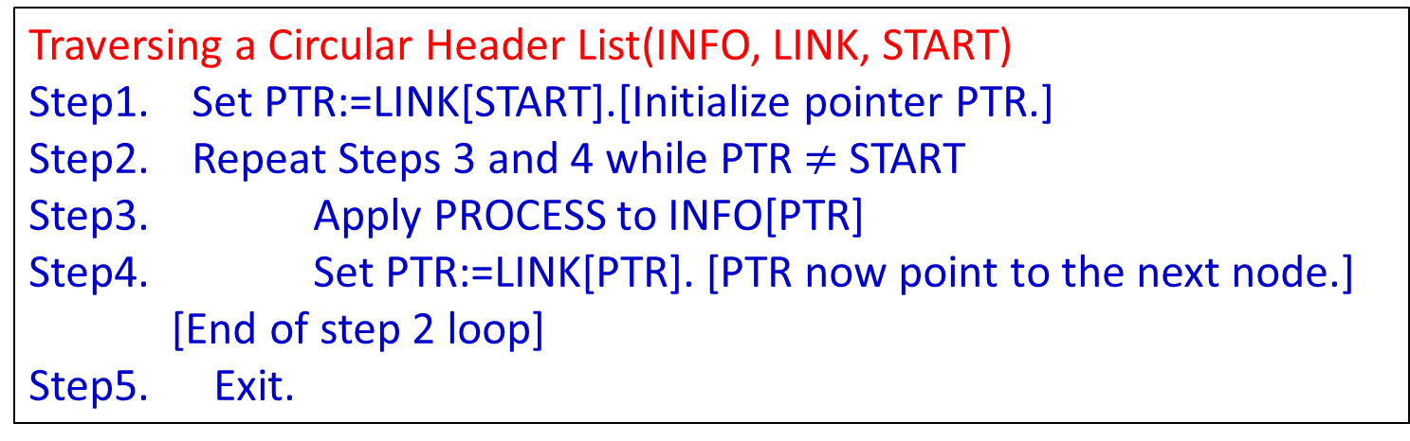
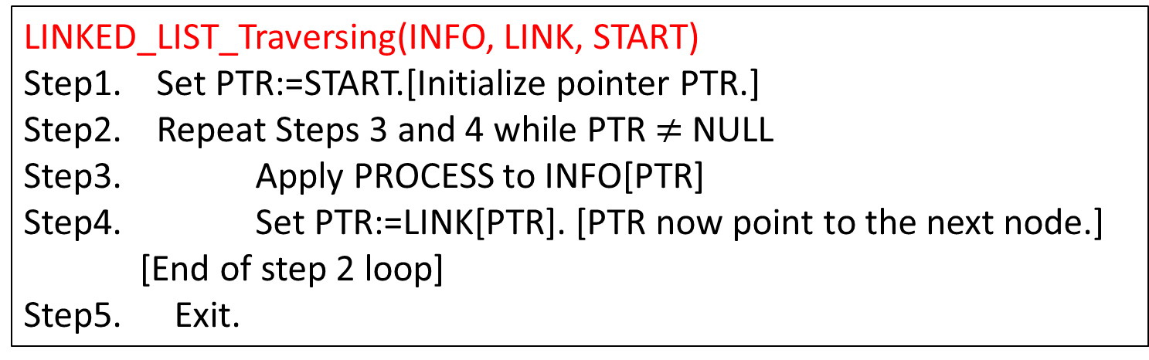
Header Linked LISTS: Traversing
Traversing a Circular Header List(INFO, LINK, START)
Step1. Set PTR:=LINK[START].[Initialize pointer PTR.]
Step2. Repeat Steps 3 and 4 while PTR$≠$ START
Step3. Apply PROCESS to INFO[PTR]
Step4. Set PTR:=LINK[PTR]. [PTR now point to the next node.]
[End of step 2 loop]
Step5. Exit.
LINKED_LIST_Traversing(INFO, LINK, START)
Step1. Set PTR:=START.[Initialize pointer PTR.]
Step2. Repeat Steps 3 and 4 while PTR$≠$ NULL
Step3. Apply PROCESS to INFO[PTR]
Step4. Set PTR:=LINK[PTR]. [PTR now point to the next node.]
[End of step 2 loop]
Step5. Exit.

Slide 12
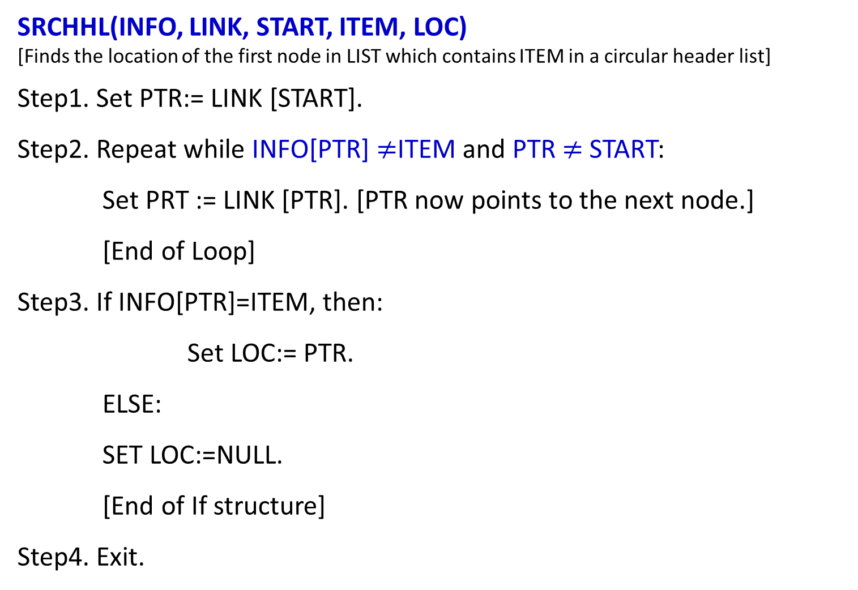
Header Linked LISTS:
(Suppose LIST is a header linked list in memory, and suppose a specific ITEM of information is given)
SRCHHL(INFO, LINK, START, ITEM, LOC)
[Finds the location of the first node in LIST which contains ITEM in a circular header list]
Step1. Set PTR:= LINK [START].
Step2. Repeat while INFO[PTR] $≠$ITEM and PTR $≠$ START:
Set PRT := LINK [PTR]. [PTR now points to the next node.]
[End of Loop]
Step3. If INFO[PTR]=ITEM, then:
Set LOC:= PTR.
ELSE:
SET LOC:=NULL.
[End of If structure]
Step4. Exit.
The two test which control the searching loop were not performed at the same time in the ordinary linked lists.

Slide 13
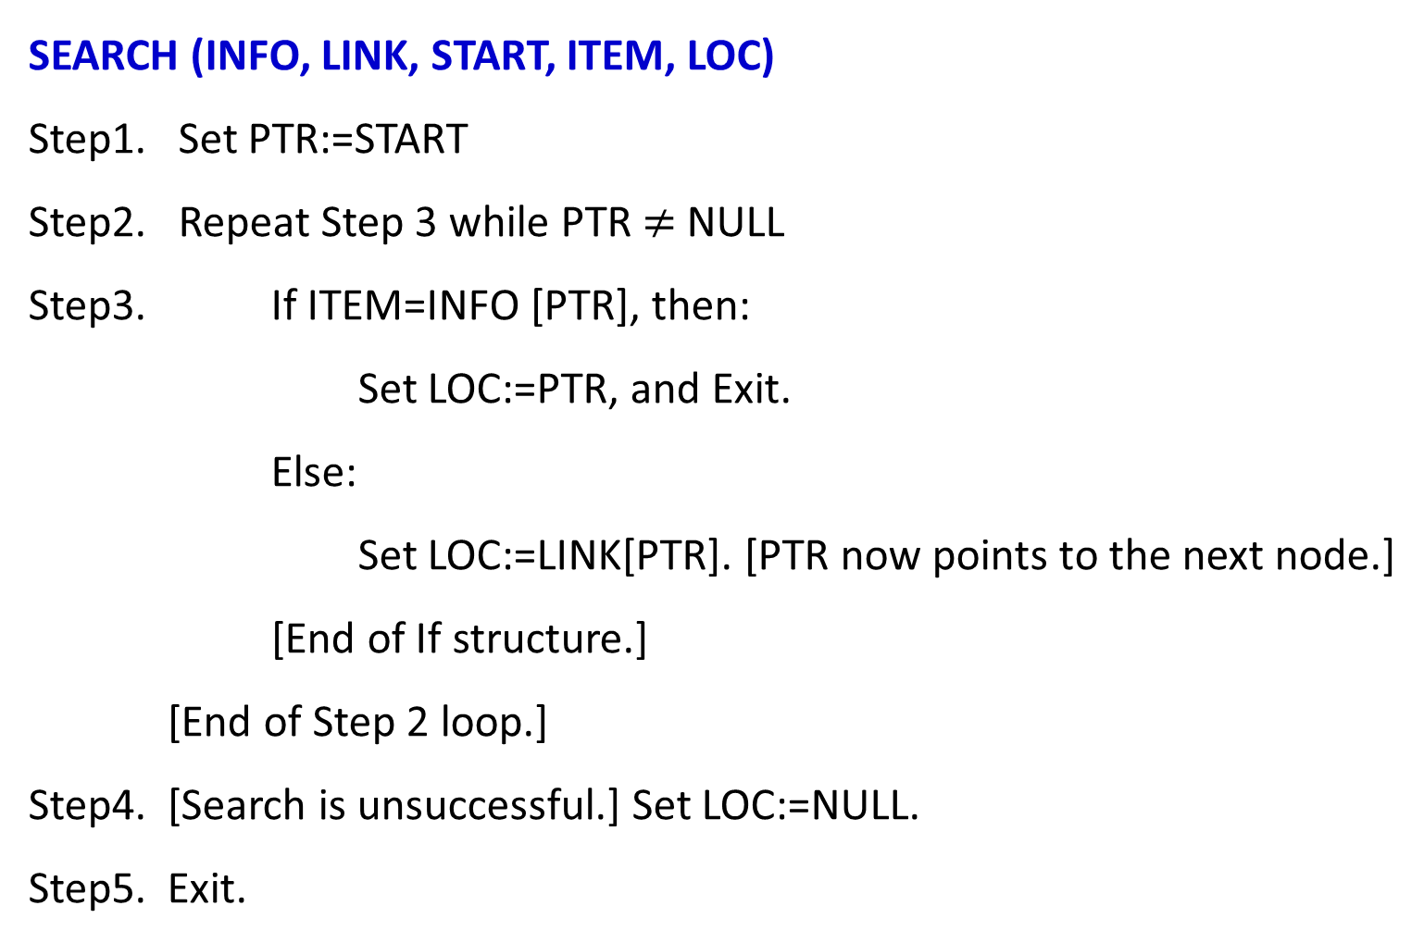
Linked LISTS: Searching
SEARCH (INFO, LINK, START, ITEM, LOC)
Step1. Set PTR:=START
Step2. Repeat Step 3 while PTR $≠$ NULL
Step3. If ITEM=INFO [PTR], then:
Set LOC:=PTR, and Exit.
Else:
Set LOC:=LINK[PTR]. [PTR now points to the next node.]
[End of If structure.]
[End of Step 2 loop.]
Step4. [Search is unsuccessful.] Set LOC:=NULL.
Step5. Exit.

Slide 14
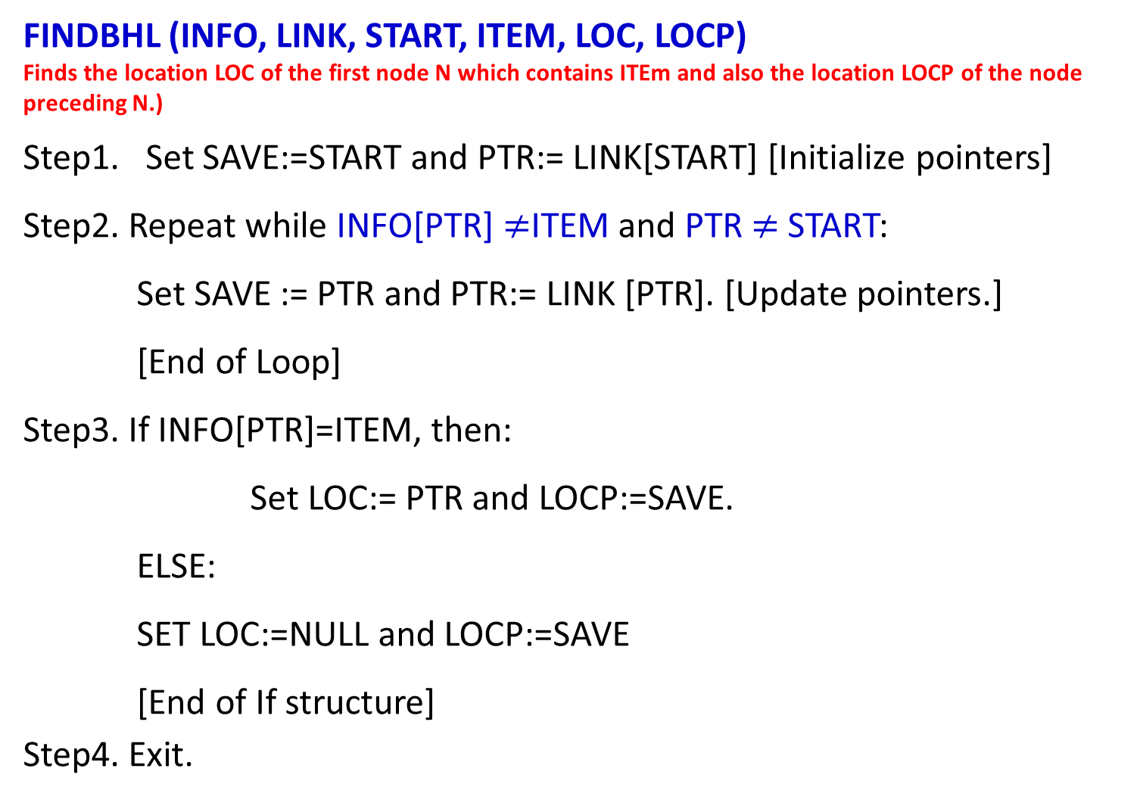
Circular Header Linked LISTS: Find Location
FINDBHL (INFO, LINK, START, ITEM, LOC, LOCP)
Finds the location LOC of the first node N which contains ITEm and also the location LOCP of the node preceding N.)
Step1. Set SAVE:=START and PTR:= LINK[START] [Initialize pointers]
Step2. Repeat while INFO[PTR] $≠$ITEM and PTR $≠$ START:
Set SAVE := PTR and PTR:= LINK [PTR]. [Update pointers.]
[End of Loop]
Step3. If INFO[PTR]=ITEM, then:
Set LOC:= PTR and LOCP:=SAVE.
ELSE:
SET LOC:=NULL and LOCP:=SAVE
[End of If structure]
Step4. Exit.

Slide 15
Circular Header Linked LISTS: Delete
DELLOCHL (INFO, LINK, START, AVAIL, ITEM)
(Deletes the first nodes N which contains ITEM when LIST is a Circular Header List.
Step1. Call FINDBHL (INFO, LINK. START, ITEM, LOC, LOCP)
Step2. If LOC=NULL, then: write: ITEM not in list, and Exit.
Step3. Set LOC[LOCP]:=LINK [LOC] [Delete Node.]
Step4. [Return deleted node to the AVAIL list.]
Set LINK[LOC]:=AVAIL and AVAIL:=LOC.
Step5. Exit

Slide 16
Thank you……

